Slide 1
Welcome to KCMS!
2016-2017

Slide 2
8th Grade Bell Schedule
Block 1 - 8:20 - 9:45
Elective - 9:49 - 11:09
LUNCH - 11:13 - 11:40
I/E - 11:44 - 12:12
Block 3 - 12:16 - 1:36
Block 4 - 1:40 - 3:00
Dismissal Prep - 3:01 - 3:10

Slide 3
ATTENDANCE
Excused Absences (labeled AEX in Power School): These are absences excused by a doctor’s note, professional counselor, school administrator or school nurse. The student is requested to bring a note from home stating the reason and number of days absent and give the note to his/her homeroom teacher.
Unexcused Absences (labeled AUX in Power School): These are absences in which the school has not received any communication from home about the absence. When a student reaches 5 or more unexcused absences for the year and 5% unexcused absences, a parent conference will be called by the school to write an attendance plan. An attendance plan is the first step in taking action before poor attendance becomes a court issue.
Parent excused Absences (labeled APX in Power School): These are absences in which the parent provided a written note or called the school regarding their child’s absence. When a student reaches 10% or more absences for the school year thus far (ex. If a child is absent 6 days within the first 60 days of school = 10%), a parent conference will be called by the school to write an attendance plan.

Slide 4
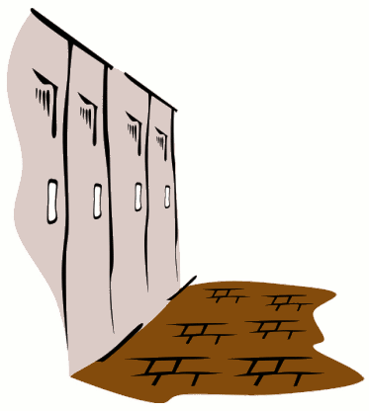
When can I go to my locker?
(You will get lockers TODAY 4th block)
Before School
After First Block
After Lunch
After School

Slide 5
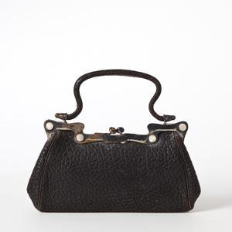
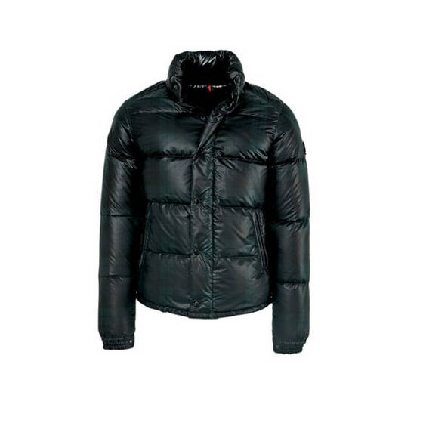
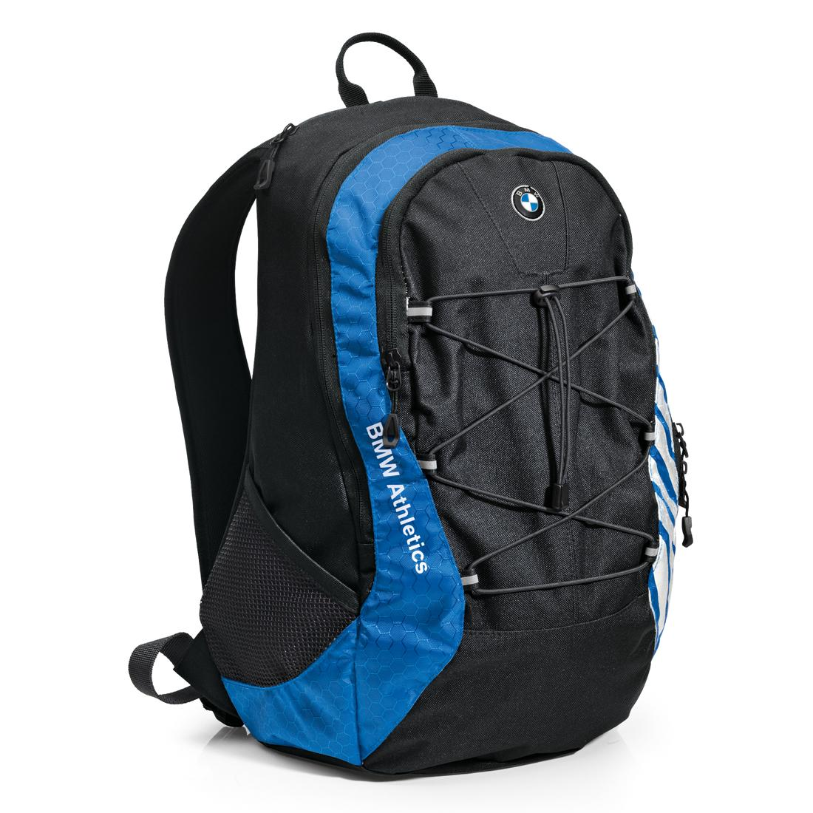
Classrooms
We know some classrooms are cold. You are welcome to bring a sweatshirt or light jacket to class, but no heavy coats.
Purses and backpacks should be left in your locker.

Slide 6
Electronics
No personal electronics may be used during the school day. Electronics should be turned OFF and out of sight. This is from the moment you walk into KCMS to the moment you leave KCMS. NOT IN THE HALLWAYS DURING DISMISSAL!!!
Each time after the first time a phone is confiscated, a parent is required to pick it up from school.

Slide 7
When can I go to the bathroom?
Before & After School
Between Classes
During Lunch - YOU MUST SIGN OUT with a TEACHER!!!
With a pass at the discretion
of your teacher -
YOU MUST SIGN OUT!

Slide 8
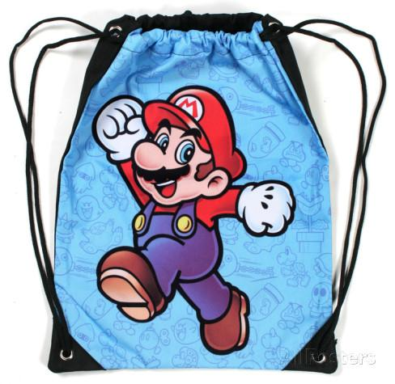
Heading to PE/Electives
Use your locker after first block and take your stuff for PE/Electives and lunch. You will NOT be allowed to go to your locker before lunch.
Gym bags are ok for PE only.

Slide 9
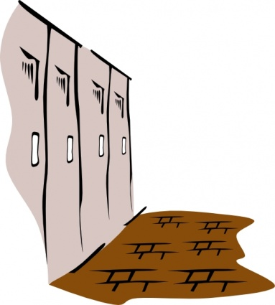
Hallway Movement
After Lunch, I/E, 3rd block you will move in an oval pattern between your classes. This means you will turn RIGHT out of your classroom and follow the “path”
to your next class without cutting
across the hall or stopping at
lockers. Like this….

Slide 10
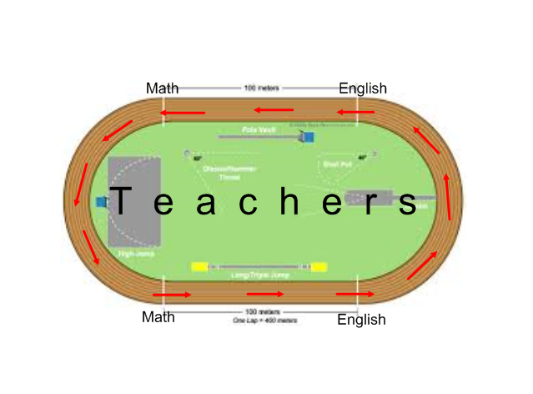
Hallway Movement

Slide 11
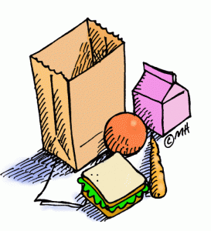
Lunch Expectations
Bring your lunch and/or money to 2nd block!
Find your assigned tables. 7 students per table. Stay seated at your 4th Block table. See next slide
A teacher will tell you when to enter the lunch line, use the restroom, dump your trash, etc.
VOLUME - the teachers will use a red/yellow card system. You will have three chances, and if it is not fixed then you will get a class wide Silent Lunch (will demonstrate at lunch).
Bathrooms - raise your hand and wait for teacher approval. Sign Out. 3 students at a time.

Slide 12
Cust. Office
Mech Room
Lunch Line 1
Lunch Line 2
DOOR
TRASHCANS
Hillyer (20)
Thacker (20)
Lingenfelter (21)
Kimsey (19)
Booth (20)
Black (22)
Dellett (20)
Add’tl Black
BR
Teachey S1 and S2
(22 + 32)
Selmer (24)
Terry (20)
Add’tl Teachey
DOOR
Podium & Table
Doors
Doors

Slide 13
WHAT’S NEW ABOUT LUNCH?
YOU WILL HAVE 2 WEEKS TO PRACTICE AND FOLLOW DIRECTIONS . . . . If you can do this then
YOU GET FREE SIT!!!
And once you earn free sit, you won’t go back!
What if it takes more than 2 weeks? You have to keep working at it and demonstrate to the teachers that you have earned free sit. Once it is earned, no going back!
HOWEVER . . .
Any student who does not follow the rules will sit at a SILENT LUNCH table (remainder of that day plus one).
REMEMBER: A teacher will dismiss 3 tables at a time from lunch. Everyone goes down guidance hallway, NOT in front of office.

Slide 14
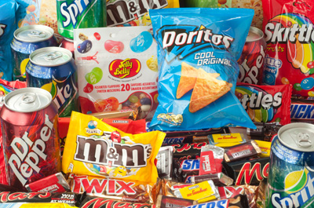
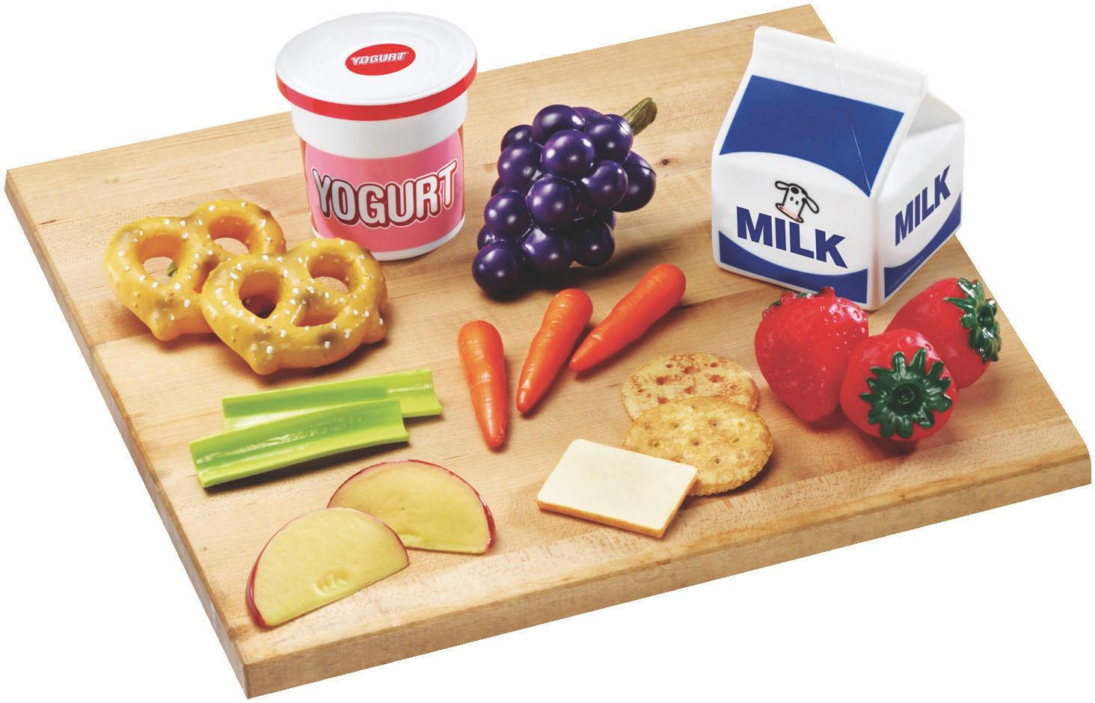
Snacks
You may bring a small healthy snack for yourself during 4th block. ALL FOOD/DRINK must stay in the CAFETERIA, LOCKER, or 4th block depending on your teacher! NO OPEN FOOD OR DRINK IN THE HALLWAY!!

Slide 15
More on Snacks
We want you to get breakfast . . . . you will not be marked tardy as long as you have your breakfast bag in hand. DO NOT EAT YOUR BREAKFAST IN THE HALLWAYS!!!!
NO OPEN FOOD OR DRINKS IN THE HALLWAYS. This means no coffee cups in the morning, no open bottles or food after lunch (it must stay in your locker). This means no eating until you are OUTSIDE of the building at the end of the day - NOT in the hallways!!!
If you have open food and/or drinks at the wrong time, you will be asked and expected to THROW IT AWAY!!!

Slide 16
BLOCK 3
Academic Success Plan

Slide 17
If you have Honors English at the high school during 4th block you need to leave this block by 1:20 and go to Mrs. Sellers in the LIBRARY.
**You will get your locker and go to the high school to Mr. McNett or Ms. Spence. You will not be dismissed early on any other day. On typical days you will be dismissed at 1:36 and need to be at the BUS LOOP at 1:40. Don’t be late!
**All Foriegn Language Students will take their class at the high school during second semester. We will readdress scheduling at that point.

Slide 18
Tardy Policy
Per SEMESTER weeks:
1st TUX = Warning
2nd TUX = Warning
3rd TUX = 1 ASD
4th TUX = 2 additional ASDs (3 total)
5th TUX = 3 additional ASDs (6 total)
6th TUX = 1 Day ISS
7th TUX = Overnight suspension

Slide 19
Learning Opportunities
What happens if I make a poor choice?
1st - Warning & Teacher calls home
2nd - Silent Lunch & Teacher calls home
3rd - After School Detention, Teachers call home, and student meets with teachers for a conference

Slide 20
After School Detention
Assigned for a 3rd Learning Opportunity - parent notification

Slide 21
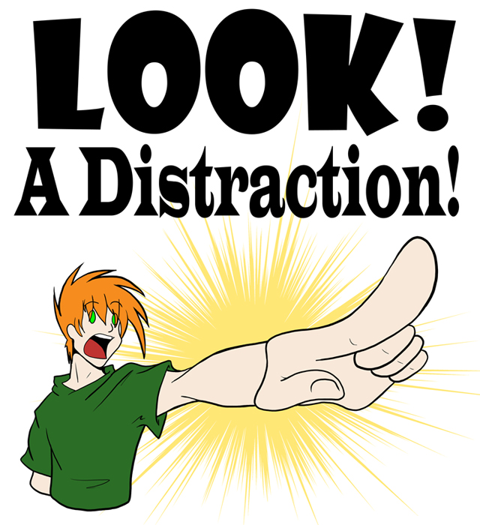
Learning Opportunity Categories
-Distracting Behaviors
-Noncompliance/Disrespect
-Unsafe Behaviors

Slide 22
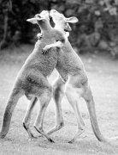
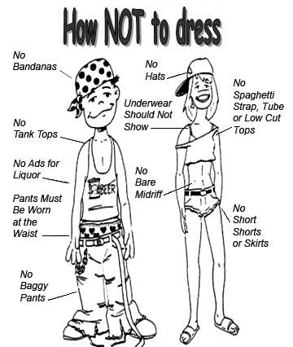
Distracting Behaviors
Unauthorized talking or noise making.
Dress code violation
Inappropriate displays of affection

Slide 23
DRESS CODE
Students should not wear the following:
• Clothing, jewelry, or personal belongings with messages of tobacco, alcohol, drugs, and vulgarity, or which reflect adversely upon persons because of their race, sex, color, creed, national origin, or ancestry.
• Headgear: hats, sunglasses, bandanas, do-rags, etc. during the school day.
• Clothing, jewelry or personal belongings that are gang related.
• Clothing that reveals undergarments or lack thereof (no spaghetti strap tops, halter tops, tube tops).
• Shorts or skirts which are shorter than where the longest finger touches on thigh.
*Leggings, stockings, or tights without shorts, skirts, or pants of above mentioned length worn
over them
• Tops that show the midriff, are inappropriately low, or are off the shoulders.
• Students must wear shoes.
• Any other attire or apparel that the administration deems as inappropriate, disruptive and unsafe to the school environment.
If dress is deemed detrimental to the educational process, a student will be asked to change. A parent will be notified when self-provided alternate clothing is not available at school.

Slide 24
Noncompliance/Disrespect
Not following directions.
Disrespect towards teachers, self, property, or students.
Provoking behaviors.
Refusal to work, sleeping.

Slide 25
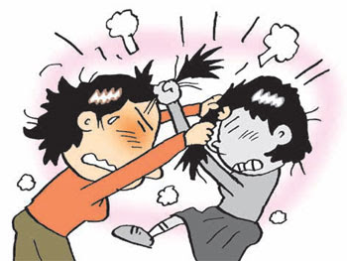
Unsafe Behaviors
Horseplay
Running
Throwing objects
Pushing/Shoving
Physical Contact

Slide 26
Block 4

Slide 27
What to do with all of those forms?
INFOSNAP . . . Please Please PLEASE take care of this. This is replacing all the forms you parent’s had to fill out. It is now ALMOST ALL ONLINE!!! (Let me know if you are having issues, we can work TOGETHER to find a solution).
Few exceptions - Field Trip Form. Must turn in to 4th block teacher ASAP
Free/Reduced Lunch - Maybe form. Bring back to 4th block teacher.
EMERGENCY CARE CARD - RETURN to 4th Block Teacher.

Slide 28
What about the other forms?
Some forms are just information.
FAMIS Information
Waynesboro Health Services
Eating Disorders
Calendar
Parent/Student Info Folder
Scoliosis
Insurance (yellow)
Bus Safety

Slide 29
Crisis Drills
In order to prepared in case of an emergency your teacher will have you practice, a code red, tornado drill, and fire drill.
This are very important for everyone's safety, including yours. Be sure to listen to your teacher and follow all directions.

Slide 30
Attendance
It is very important to attend school every day. If you have to be absent be sure to have bring in a note from home explaining why you are absent.

Slide 31
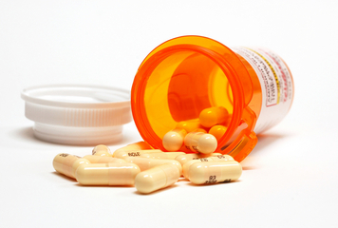
Medication and Nurse Visits
All prescription medication should be turned into the school nurse.
You may have A DAY’S WORTH of TYLENOL or IBUPROFEN with a note from your parent in the ORIGINAL CONTAINER. DO THIS.
The Nurse can NOT give you non-perscription meds

Slide 32
More On Nurse Visits
You will NOT be allowed to visit the nurse unless:
*You are bleeding more than a band-aid will cover.
*You have prescription meds that are located in the clinic.
*You HAVE thrown up.
For situations that do not fit the above requirements, TALK TO YOU YOUR TEACHER!!! Teacher discretion is allowed!
Nurse Diane had over 10,000 visits last year. We WILL NOT repeat this!

Slide 33
General Information
You are required to buy a gym uniform.
Be sure to keep your locker combination private. Do not give it out to friends.
The dress code is in your handbook. Be sure to read it. If you violate the dress code you will be asked to change. Pg 8 in handbook - Read as a class!!!
After you have been assigned a locker, you are not permitted to bring your backpack to class. This must be stored in your locker. You are responsible for bringing the required supplies for each class.
Failing Classes - pg 8 in handbook. Read as class. Talks about eligibility for sports, consequences (GIANT STEPS, Summer School, etc.)

Slide 34
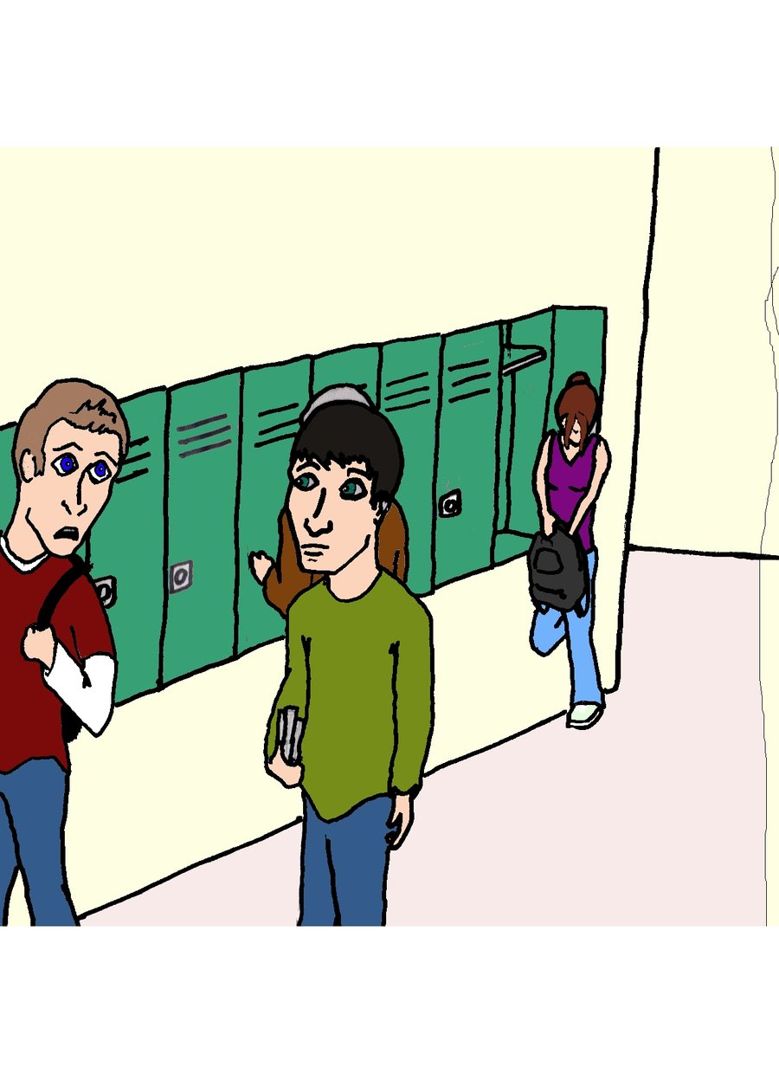
So what is acceptable hallway behavior?
Walking
Talk using your inside voice
Being respectful of those around you
Keeping your hands to yourself
Carrying school supplies in a safe and respectful manner

Slide 35
What is acceptable cafeteria behavior?
Waiting patiently in line
Talk using your inside voice
Raising your hand if you need to get up for any reason.
Being respectful of those around you
Keeping your hands to yourself
Be sure to clean up after yourself and keep the cafeteria looking good!

Slide 36
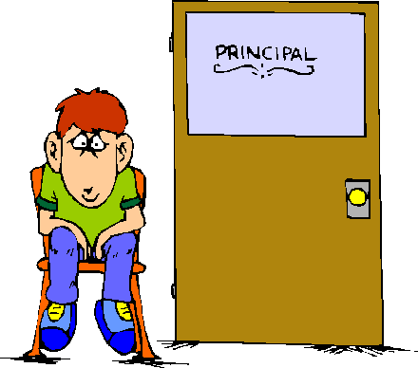
How do you stay out of the office?
Well, that's easy
Follow the rules you have discussed with your teachers and classmates today.
Show respect at all times, to your teachers, your classmates, yourself, and your school.
Use common sense.

